Slide 1


Lesson 2: Installing, Upgrading, and Migrating Servers and Workloads
MOAC 70-740: Installation, Storage and Compute with Windows Server 2016

Slide 2
Overview
Objective 1.1 — Install, upgrade, and migrate servers and workloads.
Determine Windows Server 2016 installation requirements
Determine appropriate Windows Server 2016 editions per workloads
Install Windows Server 2016
Install Windows Server 2016 features and roles
Install and configure Windows Server Core
Manage Windows Server Core installations using Windows PowerShell, command line, and remote management capabilities
Implement Windows PowerShell Desired State Configuration (DSC) to install and maintain integrity of installed environments
Perform upgrades and migrations of servers and core workloads from Windows Server 2008 and Windows Server 2012 to Windows Server 2016
Determine the appropriate activation model for server installation, such as Automatic Virtual Machine Activation (AVMA), Key Management Service (KMS), and Active Directory–based Activation.
Notes:
Lecture notes go here

Slide 3
Installing Windows Server 2016
When you install Windows Server 2016, you can select one of three installation options:
Windows Server 2016 with Desktop Experience: Previously known as Server with a GUI installation, a full installation with the GUI interface that you would expect on a Windows operating system. This installation option supports all Windows Server roles.
Windows Server 2016 Server Core: The Server Core installation that provides a command-line management interface. Because the installation does not include the GUI interface, the Server Core installation has a reduced hardware footprint and a reduced security footprint/attack surface. Unfortunately, it does not support all Windows Server roles.
Nano Server: A new installation option that was not available in Windows Server 2012 R2 or earlier. Nano Server is administered remotely and optimized for hosting in private clouds and data centers. The Nano Server runs from a VHD, either from within Hyper-V or you can boot directly from the VHD at startup.

Slide 4
Windows Server 2016 Installation Requirements
Although the hardware requirements to support Windows Server 2016 will depend on the servers that the server is hosting, the load on the server, and how responsive you want your server to be, the following is the minimum to install Server Core on a physical machine:
Processor: A 64-bit processor running 1.4 GHz
RAM: 512 MB
Free hard drive space: 32 GB

Slide 5
Windows Server 2016 Editions
The editions of Windows Server 2016 include:
Windows Server 2016 Essentials edition: Corresponds to the Windows Small Business Server from earlier versions of Windows Server, and it is designed for small businesses. Allows up to 25 users and 50 devices. Supports two processor cores and up to 64 gigabytes (GB) of random access memory (RAM). It does not support many of the features of Windows Server 2016, including virtualization.
Windows Server 2016 Standard edition: Designed for physical server environments with little or no virtualization. Provides many of the roles and features available for the Windows Server 2016 operating system and it supports up to 64 processor sockets and up to 4 terabytes (TB) of RAM. Includes licenses for up to two virtual machines and supports Nano Server installation. Licensing is processor core based.

Slide 6
Windows Server 2016 Editions
Windows Server 2016 Datacenter edition: Ideal for highly virtualized infrastructures, including private cloud and hybrid cloud environments. Provides all of the roles and features available for the Windows Server 2016 operating system and it supports up to 64 processor sockets, up to 640 processor cores, and up to 4 TB of RAM. Also includes new features such as Storage Spaces Direct and Storage Replica, along with new Shielded Virtual Machines and features for software-defined data center scenarios. Licensing is processor core based.

Slide 7
Windows Server 2016 Editions
Microsoft Hyper-V Server 2016: Acts as a stand-alone virtualization server for virtual machines. Includes all new features around virtualization in Windows Server 2016. Although it supports limited file server features, it does not support other Windows server roles. Although the host operating system has no licensing cost, the virtual machines must be licensed separately. Supports up to 64 processor sockets and up to 4 TB of RAM. It supports domain joining. Different from the Standard and Datacenter editions, Hyper-V Server edition does not have a GUI, but it does have a user interface that displays a menu of configuration tasks.

Slide 8
Windows Server 2016 Editions
Windows Storage Server 2016 Workgroup edition: An entry-level unified storage appliance. It allows 50 users, one processor core, and 32 GB of RAM.
Windows Storage Server 2016 Standard edition: A unified storage appliance that supports up to 64 sockets but is licensed on a two-socket, incrementing basis. Supports up to 4 TB of RAM and it includes two virtual machine licenses. Includes Domain Name System (DNS) and Dynamic Host Configuration Protocol (DHCP) server roles, but does not support others, including Active Directory Domain Services (AD DS), Active Directory Certificate Services (AD CS), and Active Directory Federation Services (AD FS). Licensing is processor core based.

Slide 9
Installing Windows Server 2016—Full Version
Installing Windows Server 2016 is a relatively easy process. You typically boot from the Windows Server 2016 installation disk and go through the installation wizard.
Based on the key that you specify, you will then be asked to install Server Core or Server with Desktop Experience.
Selecting the Server with Desktop Experience option provides a Server Graphical Shell, including Server Manager, and selecting Server Core provides a command prompt.

Slide 10
Installing Windows Server 2016—Full Version
To boot from a DVD drive, insert the DVD into your DVD/Blu-ray drive and turn on the computer.
If the system does not boot from the DVD, you might need to configure the BIOS Setup program to boot from the DVD/Blu-ray drive and you might need to configure the boot order so that the DVD/Blu-ray drive booting will occur before any other boot drives.

Slide 11
Install Windows Server 2016
GET READY. To install Windows Server 2016 with Desktop Experience:
Insert the Windows Server 2016 disc into the DVD drive and turn on the computer. Press any key to boot from the DVD (if necessary).
Using the drop-down lists provided, select the appropriate language to install, the time and currency format, and the keyboard or input method. Then, click Next.

Slide 12
Install Windows Server 2016
On the Windows Server 2016 Install Now page, click Install now.
When the Activate Windows page appears, in the text box, type the Windows Server 2016 activation key and then click Next.
On the Select the Operating System to Install page, select Windows Server 2016 Datacenter (Desktop Experience). Click Next.

Slide 13
Install Windows Server 2016
On the License Terms page, select the I accept the license terms option and then click Next.
Click the Custom: Install Windows only (advanced) option.
The Where Do You Want to Install Windows? page appears, as shown on next slide. From the list provided, select the partition on which you want to install Windows Server 2016, or select an area of unallocated disk space where the Setup program can create a new partition. Then click Next.

Slide 14
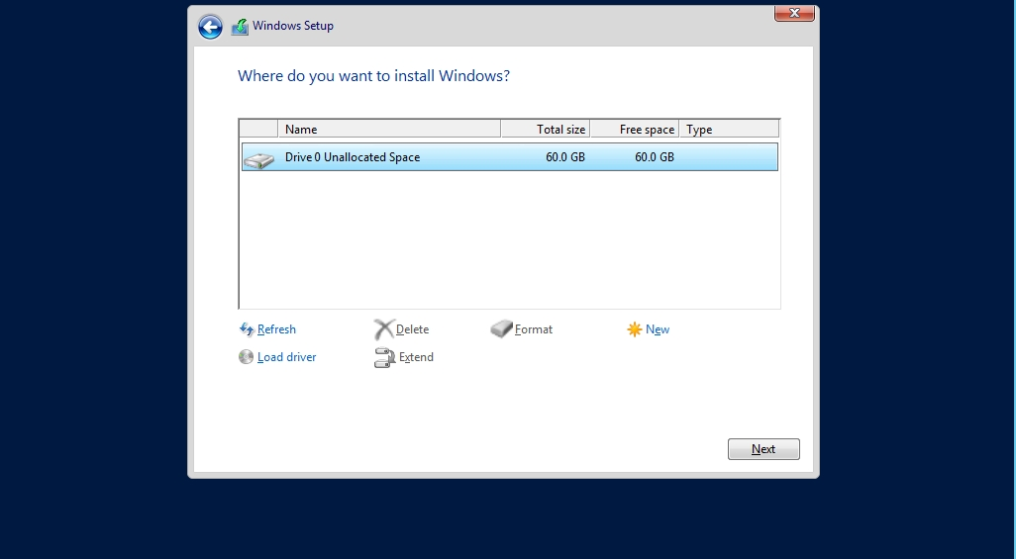
Install Windows Server 2016
Notes:
The Where Do You Want to Install Windows? page

Slide 15
Install Windows Server 2016
After several minutes, during which the Setup program installs Windows Server 2016, the computer reboots. When the Customize Settings page appears, in the Password and Reenter password text boxes, type Pa$$w0rd. Click Finish.

Slide 16
Post-Installation Configuration Settings
After you have installed Windows Server 2016, you typically should complete the following:
Configure the IP address.
Set the computer name.
Join an Active Directory domain.
Configure the time zone.
Load additional drivers that were not installed during installation.
Activate Windows.
Enable automatic updates.
Download and install updates.
(continued)

Slide 17
Post-Installation Configuration Settings
Add and configure roles and features.
Enable the Remote Desktop feature.
Configure Windows Firewall settings.
Install and configure additional applications.
Grant access to the server.

Slide 18
Installing Features and Roles
A server role is a set of software programs that perform a specific function as a network service for multiple users.
Role services are made up of one or more role services that provide the functionality of the server role.
A feature is a software program that is not directly part of a server role, but can support or augment the functionality of a server role. To add, remove, or manage server roles and features, you use Server Manager.

Slide 19
Install Features and Roles
GET READY. To install Windows Server 2016 server roles and features, perform the following steps.
Log on to LON-SVR1 as adatum\administrator with the password of Pa$$w0rd.
On LON-SVR1, to open Server Manager, click Start and then click the Server Manager tile.
When Server Manager opens, click Manage > Add Roles and Features.
In the Add Roles and Features Wizard, on the Before You Begin page, click Next.

Slide 20
Install Features and Roles
On the Select Installation Type page, Role-based or feature-based installation is already selected. Click Next.
On the Server Selection page, select the desired server. Most of the time, the local server will already be selected. Click Next.
On the Select Server Roles page (see next slide), select the desired server role. If the server role is already installed, expand the server role to select specific role services. If you are prompted to add or remove any features, click the Add Features button. Click Next.

Slide 21
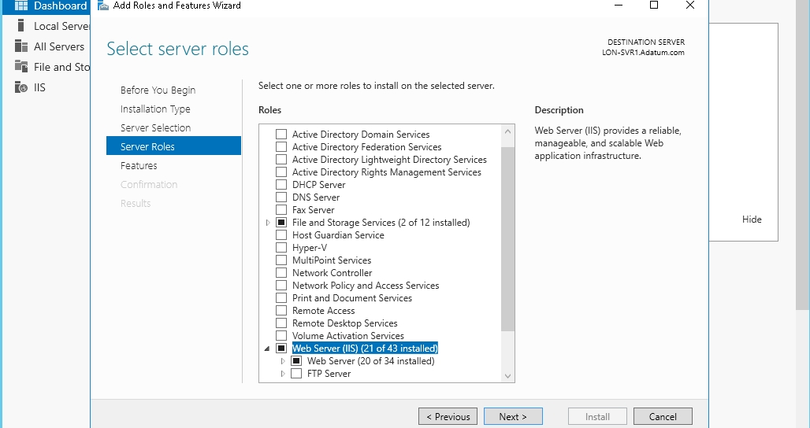
Install Features and Roles
Notes:
Selecting server roles

Slide 22
Install Features and Roles
On the Select Features page, select the appropriate features and then click Next.
On the Confirmation page, you can select the Restart the destination server automatically if required option, if desired. In either case, click Install.
When the feature or role is installed, click Close.

Slide 23
Installing and Configuring Windows Server Core
Server Core is the Windows Server 2016 installation option that provides a command-line management interface.
Because it does not have a GUI interface, it uses fewer hardware resources.
In addition, because it has fewer running components, there are fewer components that can be compromised and it requires fewer updates.
When you install Windows Server 2016, the Server Core is the default installation.

Slide 24
Installing and Configuring Windows Server Core
The following server roles are available on Server Core deployments:
Active Directory Certificate Services (AD CS)
Active Directory Domain Services (AD DS)
Dynamic Host Configuration Protocol (DHCP) Server
Domain Name System (DNS) Server
File Services (including File Server Resource Manager)
Active Directory Lightweight Directory Services (AD LDS)
Hyper-V
Print and Document Services
(continued)

Slide 25
Installing and Configuring Windows Server Core
Streaming Media Services
Web Server (including a subset of ASP.NET)
Windows Server Update Server
Active Directory Rights Management Server
Routing and Remote Access Server and the following subroles:
Remote Desktop Connection Broker
Licensing
Virtualization

Slide 26
Installing and Configuring Windows Server Core
Because Server Core does not have a GUI interface, you will have to manage it with one of the following methods:
Locally with Windows PowerShell or a command-line interface
Remotely with a remote management option

Slide 27
Install Windows Server Core
GET READY. To install Windows Server 2016 Server Core, perform the following steps.
Insert the Windows Server 2016 disc into the DVD drive and turn on the computer. Press any key to boot from the DVD (if necessary).
The computer switches to the Windows graphical interface and the Windows Setup page appears. Using the drop-down lists provided, select the appropriate language to install, the time and currency format, and the keyboard or input method. Then, click Next.

Slide 28
Install Windows Server Core
On the Windows Server 2016 Install Now page, click Install now.
When the Activate Windows page appears, in the text box, type the Windows Server 2016 activation key and then click Next.
On the Select the Operating System to Install page, select Windows Server 2016 Datacenter. Click Next.
On the License Terms page, select the I accept the license terms option and then click Next.

Slide 29
Install Windows Server Core
Click the Custom: Install Windows only (advanced) option.
The Where Do You Want to Install Windows? page appears. From the list provided, select the partition on which you want to install Windows Server 2016, or select an area of unallocated disk space where the Setup program can create a new partition. Then, click Next.
After several minutes, during which the Setup program installs Windows Server 2016, the computer reboots. When the Customize Settings page appears, in the Password and Reenter password text boxes, type Pa$$w0rd. Click Finish.

Slide 30
Managing Windows Server Core Installations
When you are connected to the system locally, you can use the following tools:
Cmd.exe: Allows you to run traditional command-line tools, such as ping.exe, ipconfig.exe, and netsh.exe.
PowerShell.exe: Opens a Windows PowerShell session so that you can execute Windows PowerShell commands. Windows Server 2016 comes with Windows PowerShell version 5.0 installed.
(continued)

Slide 31
Managing Windows Server Core Installations
Sconfig.cmd: Functions as a command-line, menu-driven administrative tool that enables you to perform most common server administrative tasks, such as configuring networking, workgroups, and domains and configuring Windows Firewall.
Regedt32.exe: Opens the Registry Editor to change registry settings.
Msinfo32.exe: Allows you to view system information for the system.
Taskmgr.exe: Launches Task Manager.

Slide 32
Create a Custom MMC and Modify Settings Remotely
GET READY. To create a custom MMC and then modify settings remotely, perform the following steps.
Right-click Start and type mmc in the Run text box. Click Yes to open the MMC Console.
In the MMC Console window, click File > Add/Remove Snap-in. The Add or Remove Snap-ins dialog box opens (as shown on next slide).

Slide 33
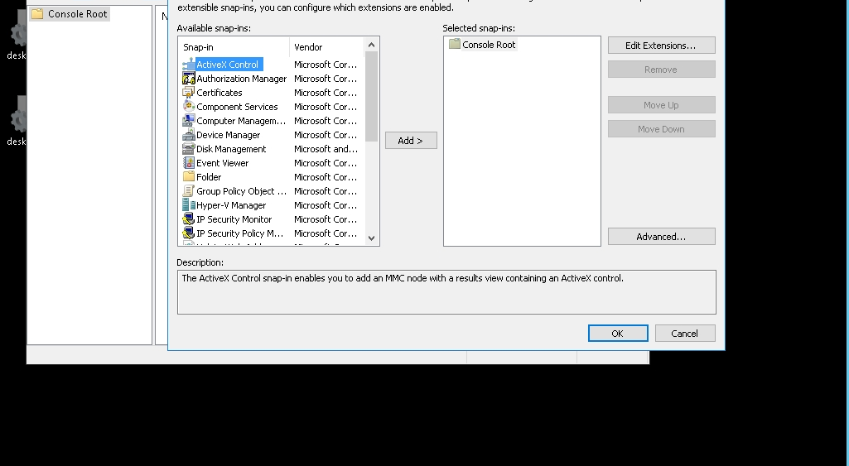
Create a Custom MMC and Modify Settings Remotely
Notes:
Selecting snap-ins for a custom MMC

Slide 34
Create a Custom MMC and Modify Settings Remotely
In the Available snap-ins list on the left, select a snap-in of your choice, such as Computer Management. In the middle of the dialog box, click Add. In the dialog box that opens, leave Local computer selected (unless the computer you want to manage is one other than the current computer).
Click Finish. The snap-in is added to the Selected snap-ins pane on the right.
Repeat Steps 2 through 4 for each snap-in you want to include in the custom MMC.

Slide 35
Create a Custom MMC and Modify Settings Remotely
When done adding snap-ins, click OK.
Click File > Save As. In the File name text box, type a name for the custom MMC and then click Save.
If you loaded the Computer Management MMC, expand System Tools > Event Viewer > Windows logs and click System.

Slide 36
Create a Custom MMC and Modify Settings Remotely
View the logs on the remote computer.
Expand the Services and Applications node and click Services.
Right-click the Computer Browser service and choose Restart.
Close the MMC console.

Slide 37
Create a Custom MMC and Modify Settings Remotely
View the logs on the remote computer.
Expand the Services and Applications node and click Services.
Right-click the Computer Browser service and choose Restart.
Close the MMC console.

Slide 38
Using Windows Remote Management
Windows Remote Management (WinRM) is a Windows Server 2016 service that enables administrators to execute commands on remote computers using Windows PowerShell or the Windows Remote Shell (WinRS.exe) command-line program.
By default, WinRM is enabled on Windows Server 2012 R2 and newer systems, but not on Windows 8.1 or Windows 10 clients.
WinRM is responsible for routing the packets to the right location, while Web Services for Management structures the packets and requires a port to be made accessible via your firewall.

Slide 39
Using Windows Remote Management
To enable remote management for a target computer, you can do one of the following:
Open a command prompt and execute the winrm quickconfig command.
Open Windows PowerShell on the computer, and then type Enable-PSRemoting.

Slide 40
Configure Remote Management with the WinRM Command
GET READY. To configure remote management with the WinRM command, log on to Windows Server 2016 using an account with administrative privileges and then perform the following steps.
Open a command prompt with administrator privileges. If the User Account Control dialog box opens prompting you to continue, click Yes.
Execute winrm quickconfig
The command prompts you to start the WinRM service.

Slide 41
Configure Remote Management with the WinRM Command
When it notifies you that it will start the WinRM service and set the WinRM service to delayed auto start, type y and then press Enter to continue.
When you are asked to create a WinRM listener, enable the WinRM firewall exception, type y, and then press Enter to continue.
Close the Administrator: Command Prompt window.

Slide 42
Using Remote Windows PowerShell
PowerShell Remoting is a server-client application that allows you to securely connect to a remote PowerShell host and run script interactively.
It allows you to run commands on a remote system as though you were sitting physically at its console.
PowerShell Remoting is built upon the Web Services for Management protocol and uses Windows Remote Management service to handle the authentication and communication elements.

Slide 43
Using Remote Windows PowerShell
There are two types of remoting:
One-to-one remoting: Allows you to bring up the PowerShell prompt on a remote computer. The credentials you use are delegated to the remote computer. Any commands you run will run under those credentials.
One-to-many remoting: Allows you to send one or more commands, in parallel, to multiple computers. Each of these computers runs the command, produces the results into an XML file, and then returns the results to your computer over the network. When the results are returned, they include the computer name.

Slide 44
Use PowerShell (One-to-One Remoting)
GET READY. To connect to a target Windows Server 2016 computer using PowerShell and one-to-one remoting, perform the following steps.
First, you need to enable PSRemoting on a target computer:
Log on with administrative privileges to a computer running Windows 10 or Windows Server 2016.
Click Start and type PowerShell. From the results, click Windows PowerShell.
From the Windows PowerShell window, type Enable-PSRemoting and then press Enter.

Slide 45
Use PowerShell (One-to-One Remoting)
If any necessary tasks need to be done, read the tasks that will be performed, type A, and then press Enter.
NEXT, from the source Windows Server 2016 computer, log on with administrative privileges to the domain and perform the following steps.
Press the Windows logo key + r, type Powershell in the Run text box, and then click OK.

Slide 46
Use PowerShell (One-to-One Remoting)
From the Windows PowerShell window, type the following and press Enter:
enter-pssession –ComputerName <computername>
Replace <computername> with your domain controller’s name. Once connected, the PowerShell prompt should include the name of the computer you are currently connected to remotely.
Type get-service and press Enter to see the services running on the domain controller.

Slide 47
Use PowerShell (One-to-One Remoting)
Type get-process and press Enter to see a list of all processes running on the domain controller.
Type get-acl c:\ and press Enter to see the access control list applied via NTFS for the C drive.
Type exit-pssession and press Enter to exit PowerShell.

Slide 48
Install Roles and Features Using the Install-WindowsFeature Cmdlet
GET READY. To install roles and features using the Install-WindowsFeature cmdlet on a computer running Windows Server 2016 Server Core, perform the following steps.
Log on with administrative privileges to a computer running Windows Server 2016 Server Core.
To open Windows PowerShell, from the command prompt, type PowerShell.exe.

Slide 49
Install Roles and Features Using the Install-WindowsFeature Cmdlet
To view the roles and features, execute Get-WindowsFeature
To install the Active Directory Domain Services role and the Group Policy Management feature on a remote server, execute the following command:
Install-WindowsFeature –Name AD-Domain-Services, GPMC –IncludeManagementTools –Restart

Slide 50
Performing a Windows Server 2016 Upgrade
An in-place upgrade is the most complicated form of Windows Server 2016 installation.
It is also the lengthiest and the most likely to cause problems during its execution.
Whenever possible, Microsoft recommends that administrators perform a clean installation, or migrate required applications and settings instead.

Slide 51
Performing a Windows Server 2016 Upgrade
An in-place upgrade is the most complicated form of Windows Server 2016 installation.
It is also the lengthiest and the most likely to cause problems during its execution.
Whenever possible, Microsoft recommends that administrators perform a clean installation, or migrate required applications and settings instead.

Slide 52
Understanding Upgrade Paths
If you want to upgrade or move an older server operating system to Windows Server 2016, you can use existing hardware and upgrade to Windows Server 2016 or you can install Windows Server 2016 on new hardware and migrate the roles, features, settings, and data from the older servers to the new server.
You can upgrade from Windows Server 2008 R2 with Service Pack 1, Windows Server 2012, or Windows Server 2012 R2 to Windows Server 2016.

Slide 53
Preparing to Upgrade
Consider the following before you perform any upgrade to Windows Server 2016:
Check hardware compatibility.
Check disk space.
Confirm that software is signed.
Check application compatibility.
Ensure computer functionality.
Perform a full backup.
Purchase Windows Server 2016.

Slide 54
Configure a System with PowerShell DSC
GET READY. To configure a system with Windows PowerShell Desired State Configuration, perform the following steps.
Log on to a server running Windows Server 2012 R2 as adatum\administrator with the password of Pa$$w0rd.
Insert the Windows Server 2016 installation disc into the DVD drive. Then open the DVD drive, and double-click the Setup program. The Windows Setup window opens.
On the Get Important Updates page, the Download and install updates (recommended) option is already selected. Click Next.

Slide 55
Configure a System with PowerShell DSC
On the Product Key page, in the Enter Product key text box, type the product key and then click Next.
Select the desired Windows version, Windows Server 2016 or Windows Server 2016 (Desktop Experience). Click Next.
On the License Terms page, click the Accept button.

Slide 56
Configure a System with PowerShell DSC
On the Choose What to Keep page, you can select the Keep personal files and apps, or Nothing. The Keep personal files and apps option will be grayed out if you are installing an edition of Windows that is different from the one you’re currently using. Click Next. If you are prompted to indicate whether you want to continue using this selection, click the Yes button.
On the Ready to Install page, click the Install button.
After several minutes, during which the Setup program upgrades Windows Server 2012 or Windows Server 2012 R2 to Windows Server 2016 and restarts the computer several times, the system finalizes the installation and the Windows sign-on screen appears.

Slide 57
Migrating Server and Core Workloads
Many roles included with Windows Server 2016 involve a lot of configuring.
A particular role might require policies, security, or other settings that you must configure before it can be used.
Thus, when you want to migrate such roles, you want to find a way that can migrate them and all their configuration settings to another server quickly and easily without having to install and configure the role from the beginning.
If you search for Migrating Roles and Features in Windows Server, you should find a list of available migration guides, including how to use the Windows Server Migration Tools (WSMT) and how to migrate individual roles from one server to another.

Slide 58
Use Windows Server Migration Tools
GET READY. To migrate the DHCP server from one server to another, perform the following steps.
On the source server, using Server Manager, open the Tools menu and click Services.
Right-click the DHCP Server service and choose Stop.
On the source server, using Server Manager, open the Tools menu and then click Windows Server Migration Tools > Windows Server Migration Tools.

Slide 59
Use Windows Server Migration Tools
GET READY. To migrate the DHCP server from one server to another, perform the following steps.
In the Windows Server Migration Tools window, execute the following command:
Export-SmigServerSetting -featureID DHCP -User All -Group -IPConfig –path \\rwdc01\software -Verbose
When prompted for a password, type Pa$$w0rd and press Enter.
On the target server, using Server Manager, click Tools > Services.

Slide 60
Use Windows Server Migration Tools
Right-click the DHCP Server and choose Stop.
On the target server, using Server Manager, click Tools > Windows Server Migration Tools > Windows Server Migration Tools.
Execute the following command:
Import-SmigServerSetting -featureID DHCP -User All -Group -IPConfig –SourcePhysicalAddress “00-15-5D-01-32-24” –TargetPhysicalAddress “00-15-5D-01-32-1F” –path \\rwdc01\software -Verbose
Back on the Services console, right-click the DHCP Server service and choose Start.

Slide 61
Activating Windows Server 2016
Activation helps verify that your copy of Windows is genuine and that it has not been used on more computers than the Microsoft Software Terms allow.
Windows Server 2016 requires product activation, which validates each Windows Server 2016 license through an online activation service at Microsoft by phone, through KMS, or through Active Directory Domain Services, in order to be fully functional.
During the activation step, you install the proper license key for Windows.

Slide 62
Implementing Volume Activation Using KMS
Key Management Service (KMS) is a service that activates Volume License versions of Windows Vista and later as well as Office 2010 and later.
To activate operating systems, you need at least 25 client operating systems or 5 server operating systems.
When you use Volume Activation Services, each activated computer must contact the KMS server periodically to renew its activation status.
Activation lasts for 180 days and attempts to renew with the KMS host every 7 days by default. The KMS host is found by referencing an SRV record in DNS.

Slide 63
Install and Configure a KMS
GET READY. On a server running Windows Server 2016, to install and configure a Key Management Service (KMS), perform the following steps.
Log on to LOpassword of Pa$$Word. If Server Manager does not open, click Start and click Server Manager.
When Server Manager opens, open the Manage menu and click Add Roles and Features.
When the Add Roles and Features Wizard opens, on the Before You N-SVR1 as Adatum\administrator with the Begin page, click Next.

Slide 64
Install and Configure a KMS
On the Server Selection page, click Next.
On the Server Roles page, select the Volume Activation Services option. When you are prompted to add additional features, click Add Features. Click Next.
On the Features page, click Next.
On the Volume Activation Services page, click Next.
On the Confirmation page, click Install.

Slide 65
Install and Configure a KMS
When the Volume Activation Tool is installed, click Close.
In Server Manager, click Tools > Volume Activation Tools.
In the Volume Activation Tools Wizard, on the Introduction page, click Next.
On the Select Volume Activation Method page (see next slide), select the Key Management Service (KMS) option.

Slide 66
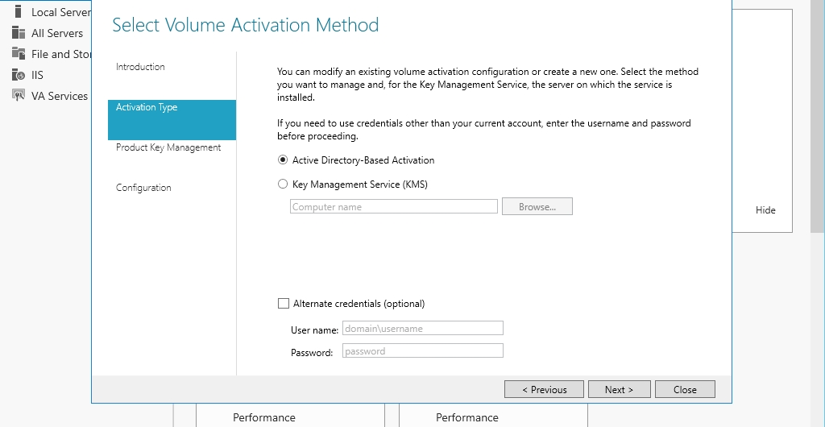
Install and Configure a KMS

Slide 67
Install and Configure a KMS
In the Key Management Service (KMS) text box, type LON-SVR1. Click Next.
On the Manage KMS Host page, in the Install your KMS host key text box, type your key. Click Commit.
On the Product Key Management page, the Activate Product option is already selected. Click Next.
On the Activate Product page, the Activate online option is already selected. Click Commit.

Slide 68
Implementing Active Directory–Based Activation
Active Directory–Based Activation (ADBA) is a new feature for Windows 8 and higher, and Windows Server 2012 and higher, which enables enterprises to activate computers when a computer is joined to the domain, as long as the computer has a Generic Volume License Key (GVLK) installed.
No single physical computer is required to act as the activation object because it is distributed throughout the domain.
To activate an ADBA forest online, you need to specify a KMS host key, and optionally specify an Active Directory–Based Activation Object display name.

Slide 69
Implementing Active Directory–Based Activation
To use ADBA, you need to extend the domain to Windows Server 2012 or higher. You then:
Install the Volume Activation Services server role on a domain controller.
Add a KMS host key by using the Volume Activation Tools Wizard.
Microsoft verifies the KMS host key, and an activation object is created.
Client computers are activated by receiving the activation object from a domain controller during startup.

Slide 70
Install and Configure Active Directory–Based Activation
GET READY. On a server running Windows Server 2016, to install and configure the Active Directory-Based Activation, perform the following steps.
Log on to LON-SVR1 as Adatum\administrator with the password of Pa$$Word.
In Server Manager, click Tools > Volume Activation Tools.
In the Volume Activation Tools Wizard, on the Introduction page, click Next.

Slide 71
Install and Configure Active Directory–Based Activation
On the Select Volume Activation Method page, select Active Directory–Based Activation. Click Next.
On the Manage Activation Objects page, in the Install your KMS host key text box, type in your key and click Next.
On the Product Key Management page, the Activate Product option is already selected. Click Next.
On the Activate Product page, the Activate online option is already selected. Click Commit.

Slide 72
Implementing Automatic Virtual Machine Activation
Automatic Virtual Machine Activation (AVMA) was introduced with Windows Server 2016 and allows you to activate your Windows virtual machines without using a KMS server or even a network connection.
Different from a KMS, the activation will only last seven days, after which it would need to be renewed again.

Slide 73
Implementing Automatic Virtual Machine Activation
To use AVMA, you need to have a server running Windows Server 2012 R2 Datacenter or Windows Server 2016 Datacenter with Hyper-V.
The virtual machines need to be running Hyper-V.
Windows Server 2016 AVMA can activate guests that run the Datacenter, Standard, or Essentials editions of Windows Server 2012 R2 or Windows Server 2016.

Slide 74
Implementing Automatic Virtual Machine Activation
The basic steps to set up AVMA:
Install Windows Server 2012 R2 or Windows Server 2016 Datacenter.
Activate Windows Server 2012 R2 or Windows Server 2016 Datacenter.
Install Hyper-V on a Windows Server 2012 R2 or Windows Server 2016 server.
Create a virtual machine and install a supported server operating system on it.
Install the AVMA key in the virtual machine by opening an elevated command prompt and run the following command:
slmgr /ipk <AVMA_key>

Slide 75
Querying and Configuring Activation States Using the Command Line
The Windows activation process is handled by the Software Licensing Manager (SLMgr) module, also known as the Windows Software Licensing Management Tool.
A VBScript called slmgr.vbs keeps track of licensing details.
Slmgr.vbs allows users to query the current installation and see details about the Windows installation and its activation and licensing status.

Slide 76
Implementing Windows PowerShell DSC
When you manage several servers in a data center, configuring all of those servers requires a lot of work.
The burden of managing several is eased when those servers share a common configuration.
To reduce the time necessary to configure all your data center servers, you can use Windows PowerShell Desired State Configuration (DSC) to manage and maintain systems based on your declared configuration.

Slide 77
Implementing Windows PowerShell DSC
Some of the configurations that you can apply include:
Enabling or disabling server roles and features
Managing registry settings
Managing files and directories
Starting, stopping, and managing processes and services
Managing groups and user accounts
Deploying new software
Managing environment variables
Running Windows PowerShell scripts

Slide 78
Implementing Windows PowerShell DSC
The Local Configuration Manager (LCM) is the Windows PowerShell DSC engine.
It will periodically check whether the configuration is still valid or if drift has occurred. When you configure the LCM, you will either push the configuration to a server, or you will establish an HTTP server or SMB share, from which the systems will pull the configuration.
You will then specify how often it will retrieve the configuration and how often it will check and apply the specified configuration.

Slide 79
Configure a System with Windows PowerShell DSC
GET READY. To configure a system with Windows PowerShell Desired State Configuration, perform the following steps.
Log on to LON-SVR1 as adatum\administrator with the password of Pa$$w0rd.
If Server Manager does not open, click Start and click Server Manager.
Click Tools > Windows PowerShell ISE.
When Windows PowerShell ISE opens, in the top white pane, type text shown on the next slide.

Slide 80
Configure a System with Windows PowerShell DSC
configuration MyFirstServerConfig
{
WindowsFeature snmp
{
Name = “SNMP-Service”;
Ensure = “Present”
}
WindowsFeature DSCServiceFeature
{
Name = “DSCServiceFeature”;
Ensure = “Present”
}
Service Spooler
{
Name = "Spooler"
StartupType = "Manual"
State = "Stopped"
}
}
MyFirstServerConfig

Slide 81
Configure a System with Windows PowerShell DSC
Click File > Save As. In the Save As dialog box, in the File name text box, type C:\Config.ps1 and click the Save button.
Click the blue, bottom pane. Then in the blue, bottom pane, type CD\ and press Enter.
To create the .mof file, from the Windows PowerShell command prompt, execute\config1.ps1
At the Windows PowerShell command prompt, execute:
Start-DscConfiguration –Wait –Verbose –Path C:\MyFirstServerConfig

Slide 82
Lesson Summary
Before installing Windows Server 2016, you need to first determine the minimum hardware requirements so that you can ensure you have the correct hardware. The minimum hardware can then be used to gauge what is needed to carry the necessary load.
Similar to previous Windows Server operating systems, you can choose from multiple editions.
These editions allow you to select the edition that you need rather than paying for all features, some of which you do not need.
Server Core is a Windows Server 2016 installation option that provides a command-line management interface. Because it does not have a GUI interface, it uses fewer hardware resources. Because it has fewer running components, there are fewer components that can be compromised and it requires fewer updates. When you install Windows Server 2016, Server Core is the default installation.

Slide 83
Lesson Summary
You can use Remote Desktop Connections and the Windows Server 2016 Administrative Tools to manage remote servers.
You can also use PowerShell Remoting, which allows you to securely connect to a remote PowerShell host and run scripts interactively.
An in-place upgrade is the most complicated form of Windows Server 2016 installation. It is also the lengthiest and the most likely to cause problems during its execution.
Whenever possible, Microsoft recommends that administrators perform a clean installation, or migrate required applications and settings instead.

Slide 84
Lesson Summary
Many roles included with Windows Server 2016 involve a lot of configuring. A role might require policies, security, or other settings that you must configure before it can be used. Therefore, when you want to migrate such roles, you want to find a way that can migrate them and all their configuration settings to another server quickly and easily without having to install and configure the role from the beginning.
Activation helps verify that your copy of Windows is genuine and that it has not been used on more computers than the Microsoft Software Terms allow.
Windows Server 2016 requires product activation, which validates each Windows Server 2016 license through an online activation service at Microsoft by phone, through KMS, or through Active Directory Domain Services, to be fully functional. During the activation step, you install the proper license key for Windows.

Slide 85
Copyright 2017 John Wiley & Sons, Inc.
All rights reserved. Reproduction or translation of this work beyond that named in Section 117 of the 1976 United States Copyright Act without the express written consent of the copyright owner is unlawful. Requests for further information should be addressed to the Permissions Department, John Wiley & Sons, Inc. The purchaser may make back-up copies for his/her own use only and not for distribution or resale. The Publisher assumes no responsibility for errors, omissions, or damages, caused by the use of these programs or from the use of the information contained herein.

